Slide 1
MIPS
Instruction Set Architecture
19CSE211 COA
Session 5
19-01-2021

Slide 2
Computer Architecture
In computer engineering, computer architecture is a set of rules and methods that describe the functionality, organization, and implementation of computer systems.
Some definitions of architecture define it as describing the capabilities and programming model of a computer but not a particular implementation.
In other definitions computer architecture involves instruction set architecture design, micro-architecture design, logic design, and implementation
H.C. TD5102

Slide 3
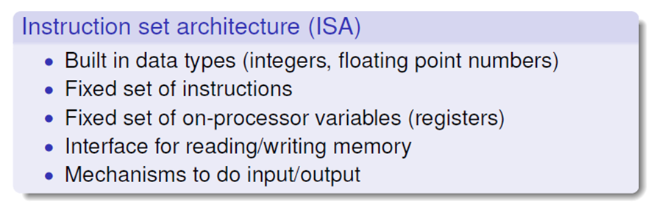
To make up an architecture, Instruction Set Architecture (ISA) is needed because it has a set of instructions that the processor understands.
H.C. TD5102

Slide 4
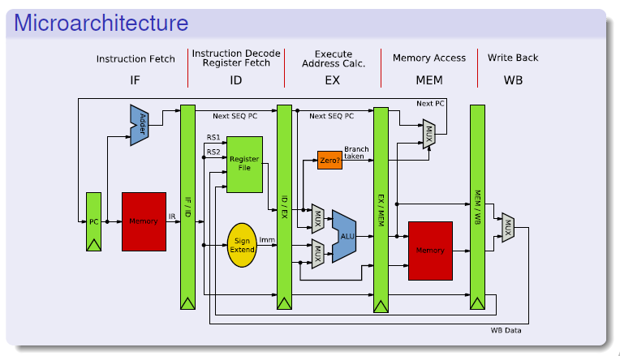
H.C. TD5102

Slide 5
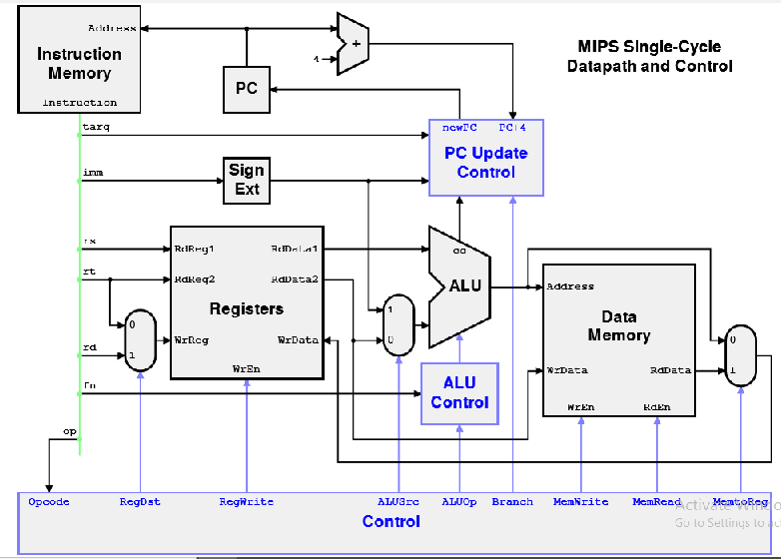
H.C. TD5102

Slide 6
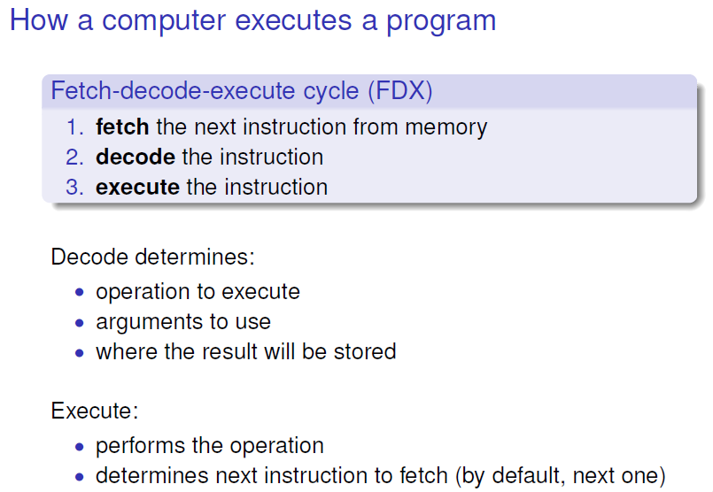
H.C. TD5102

Slide 7
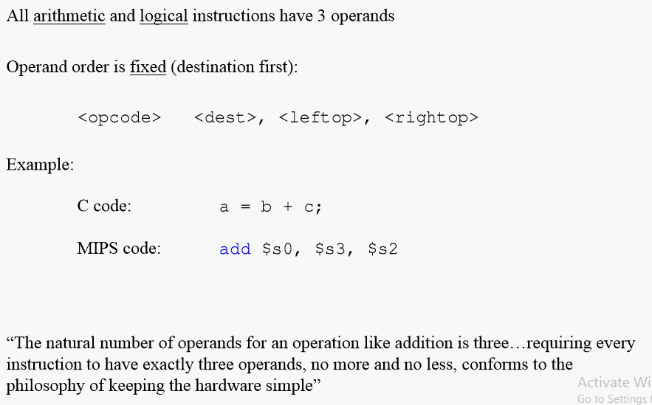
H.C. TD5102

Slide 8
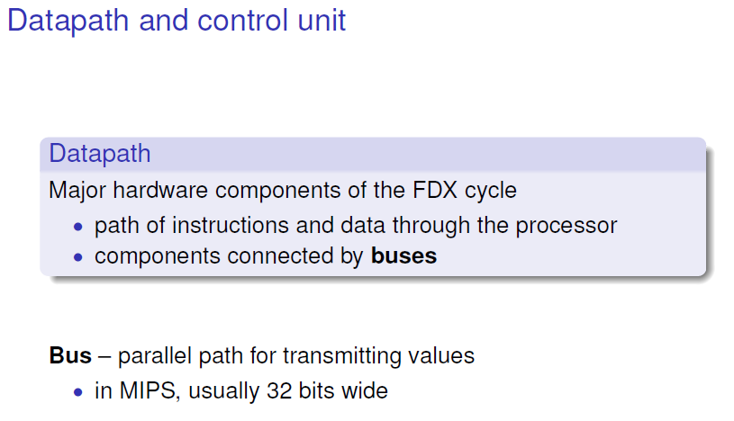
H.C. TD5102

Slide 9
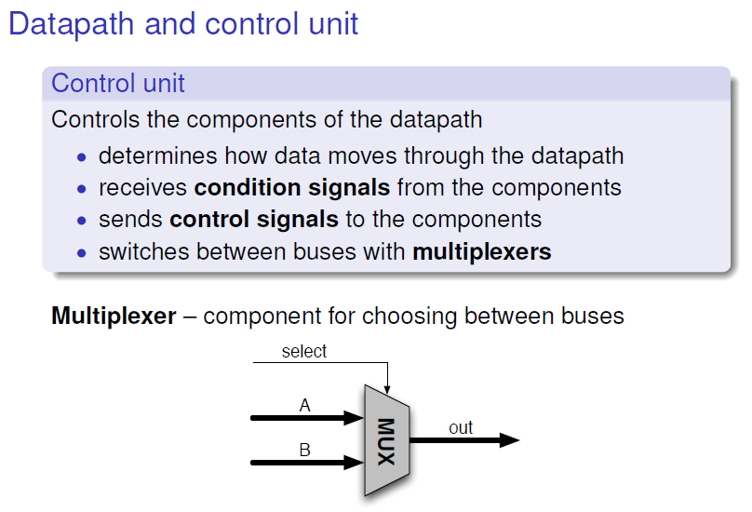
H.C. TD5102

Slide 10
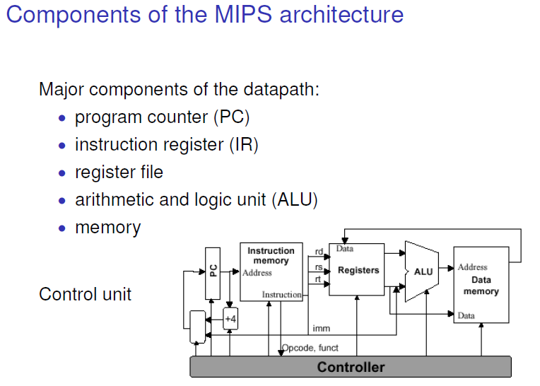
H.C. TD5102

Slide 11
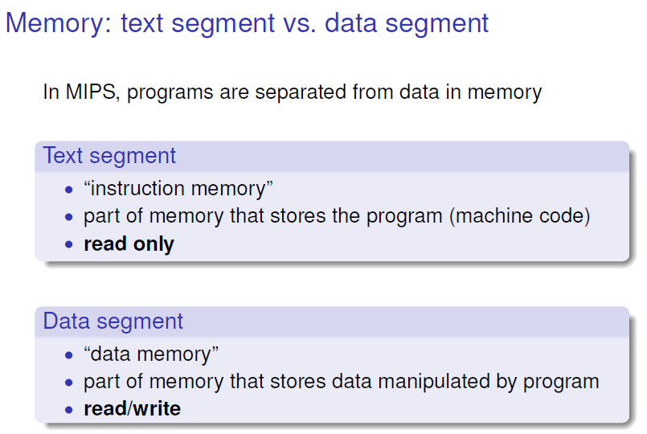
H.C. TD5102

Slide 12
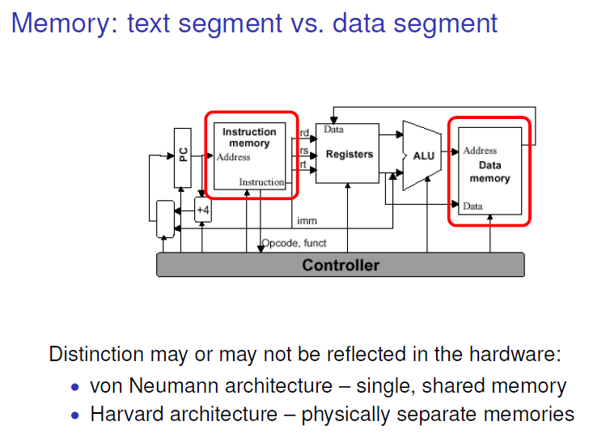
H.C. TD5102

Slide 13
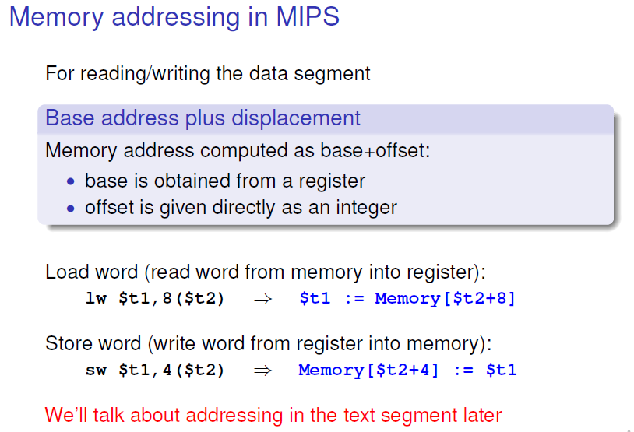
H.C. TD5102

Slide 14
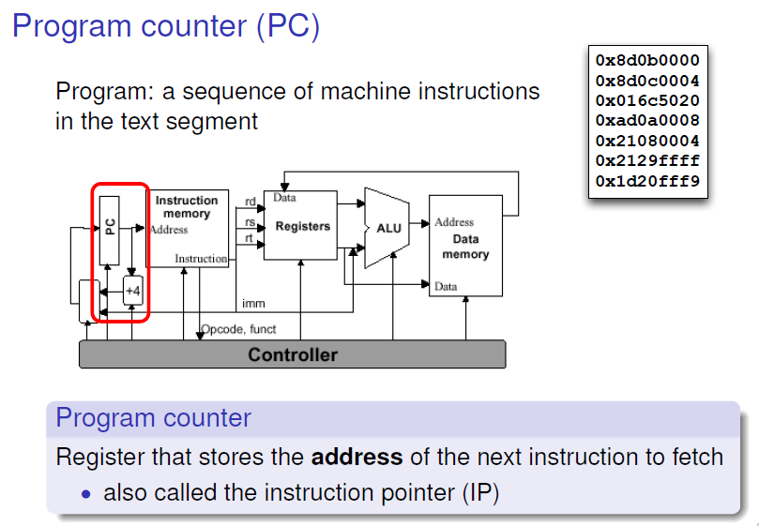
H.C. TD5102

Slide 15
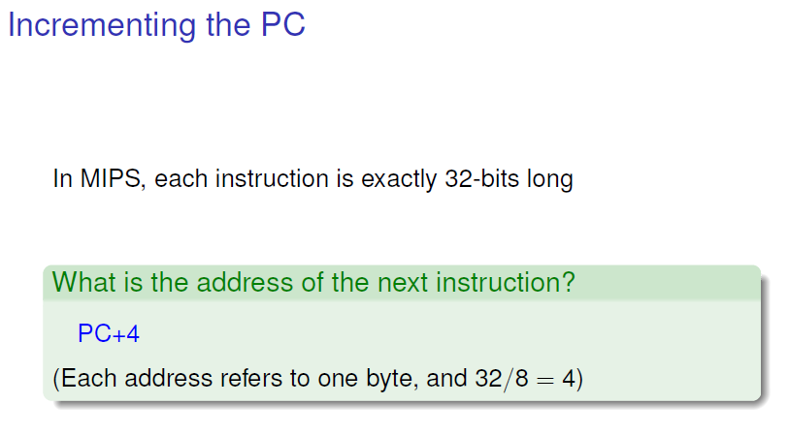
H.C. TD5102

Slide 16
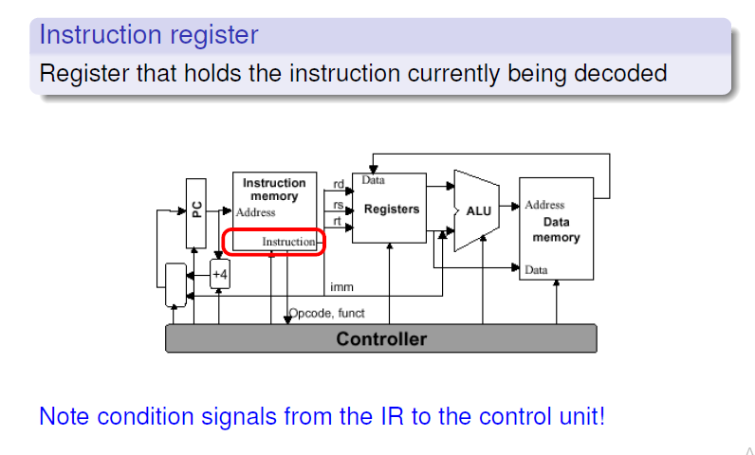
H.C. TD5102

Slide 17
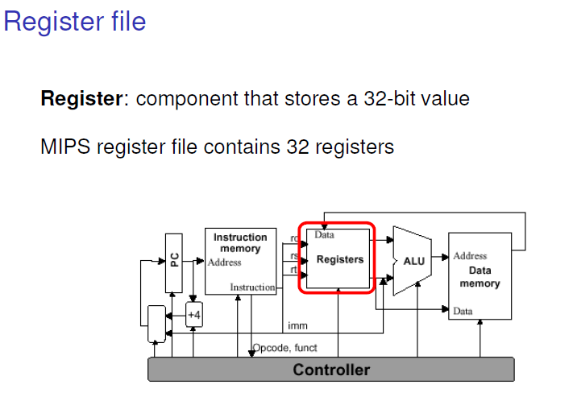
H.C. TD5102

Slide 18
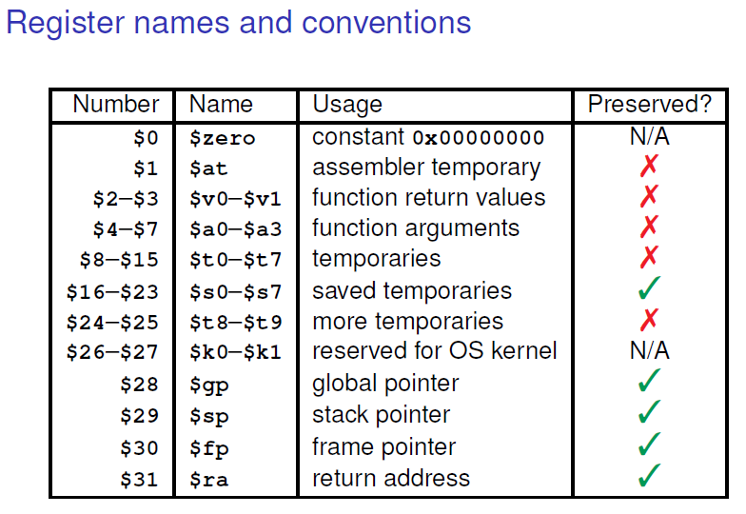
H.C. TD5102

Slide 19
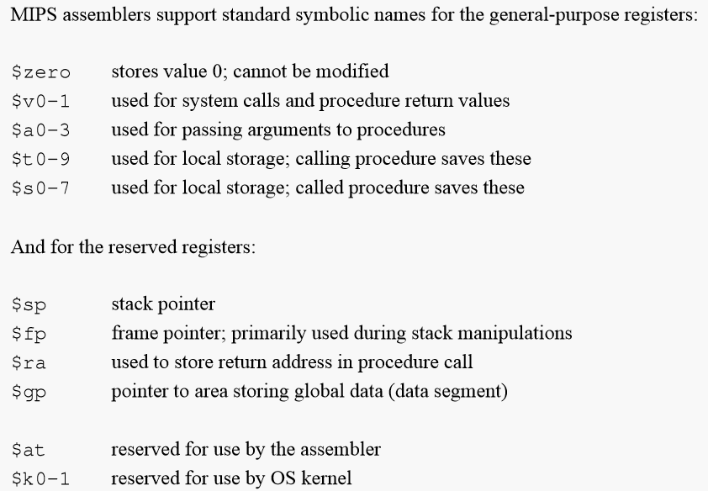
H.C. TD5102

Slide 20
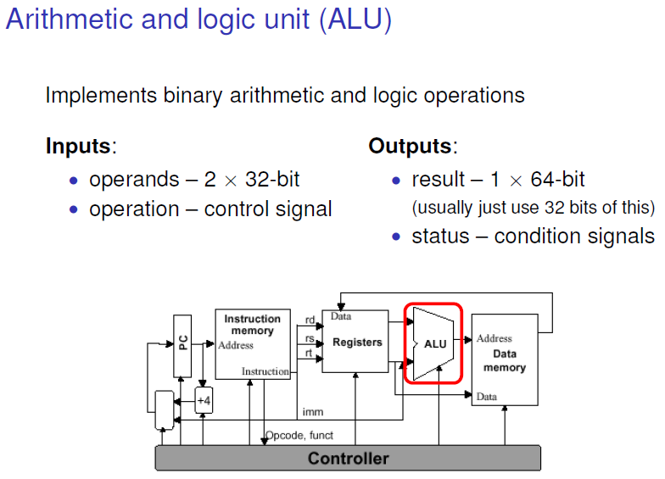
H.C. TD5102

Slide 21
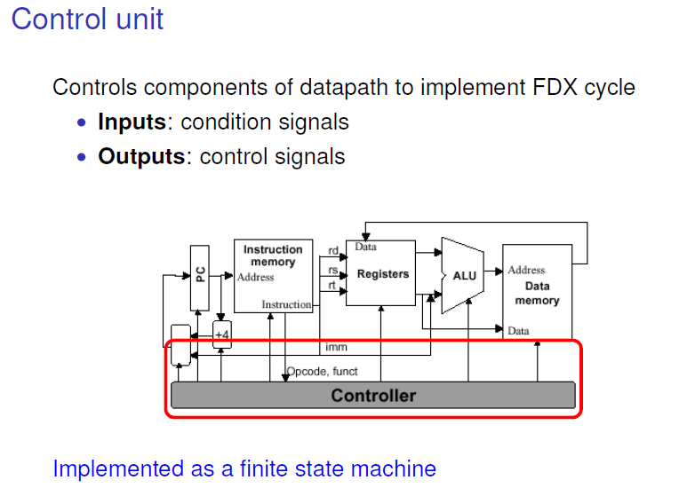
H.C. TD5102

Slide 22
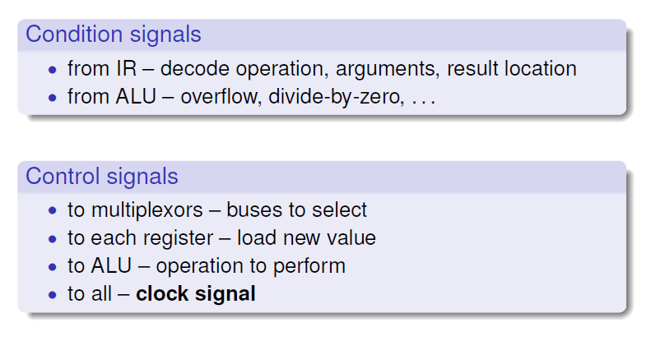
Control Unit
H.C. TD5102

Slide 23
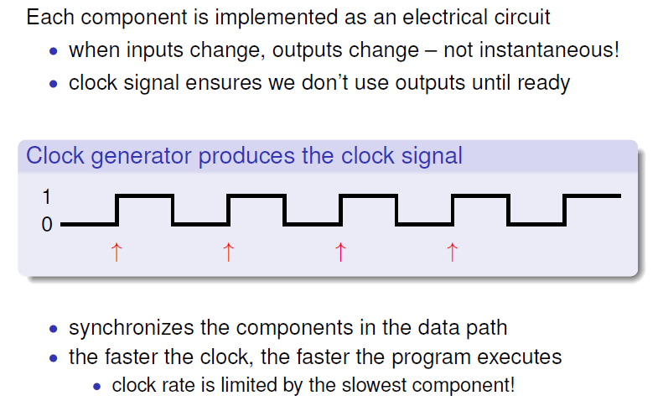
Clock Signal
H.C. TD5102

Slide 24
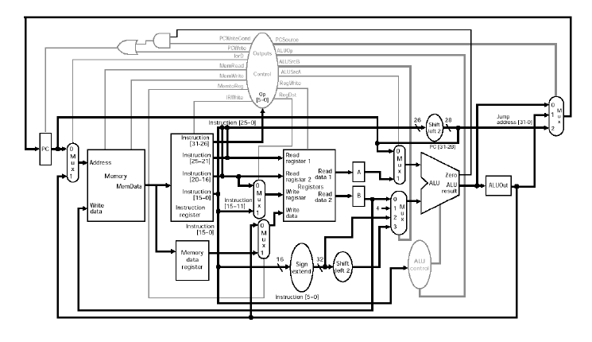
MIPS Data path with Control Signals
H.C. TD5102

Slide 25
MIPS
Instruction Set Architecture
Courtesy: Henk Corporaal
http://www.ics.ele.tue.nl/~heco/courses/EmbSystems
Technical University Eindhoven
DTI / NUS Singapore

